Slide 1

DIGITAL LOGIC DESIGN (111776)
Dr. Owais Hussain

Slide 2

Agenda
Encoders
Octal Encoders
Decimal Encoders
Hex Encoders
Priority Enconders

Slide 3
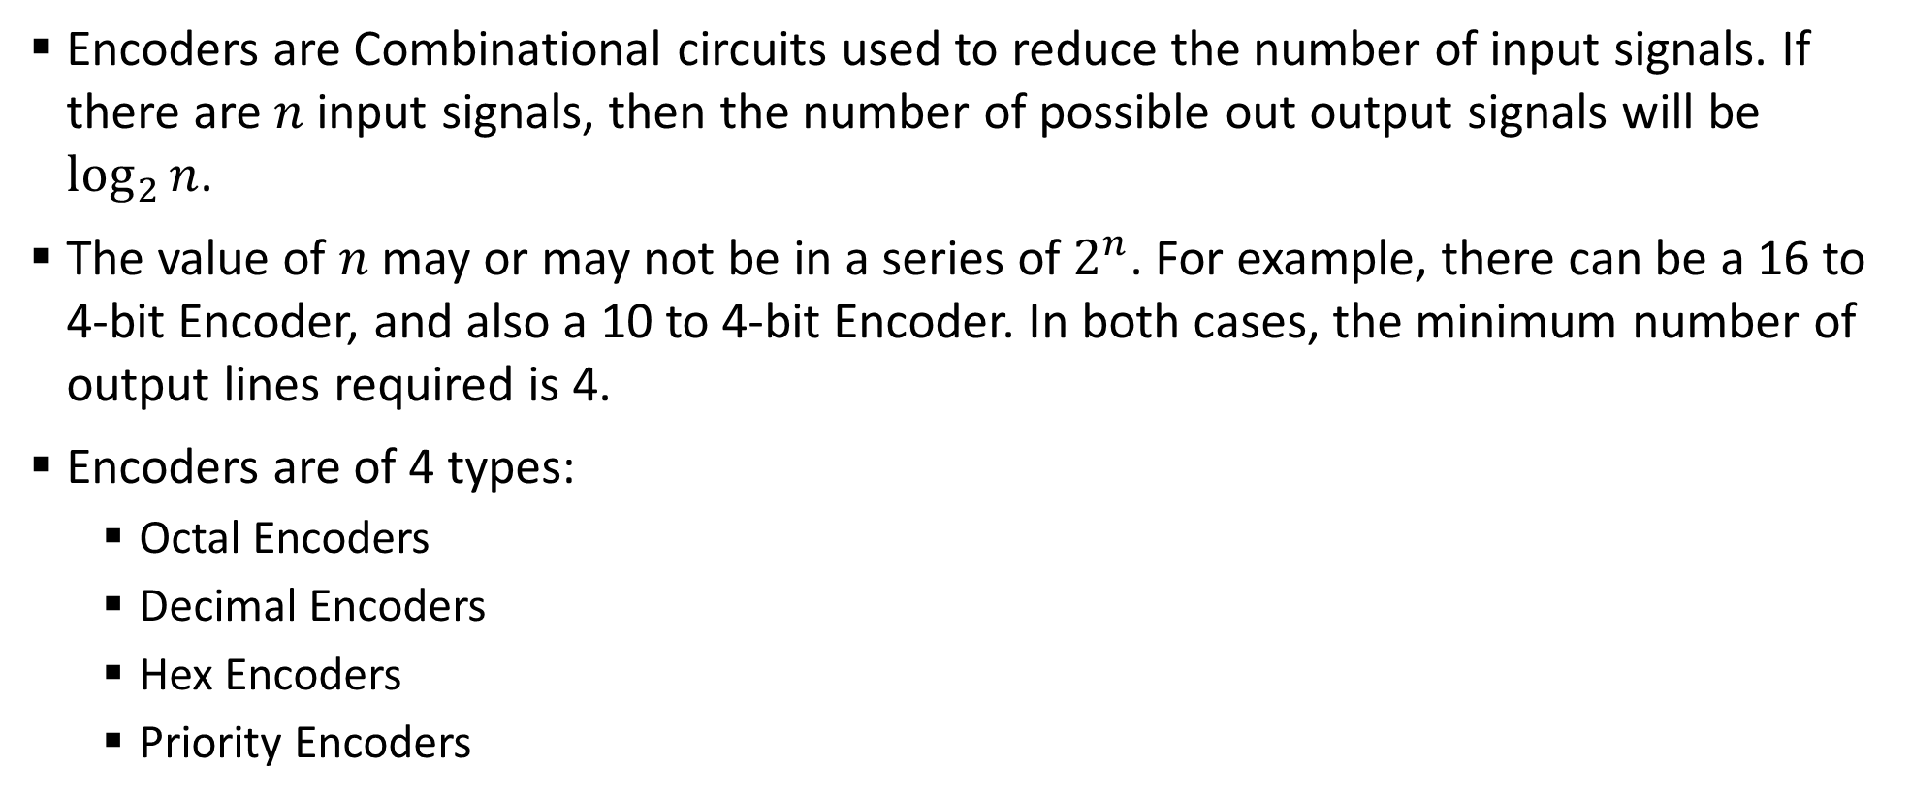
Sample 2
Encoders
Encoders are Combinational circuits used to reduce the number of input signals. If there are $n$ input signals, then the number of possible out output signals will be $\log_{2}{n}$.
The value of $n$ may or may not be in a series of $2^{n}$. For example, there can be a 16 to 4-bit Encoder, and also a 10 to 4-bit Encoder. In both cases, the minimum number of output lines required is 4.
Encoders are of 4 types:
Octal Encoders
Decimal Encoders
Hex Encoders
Priority Encoders

Slide 4
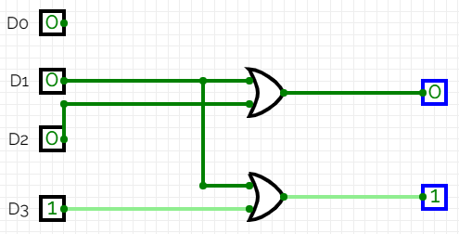
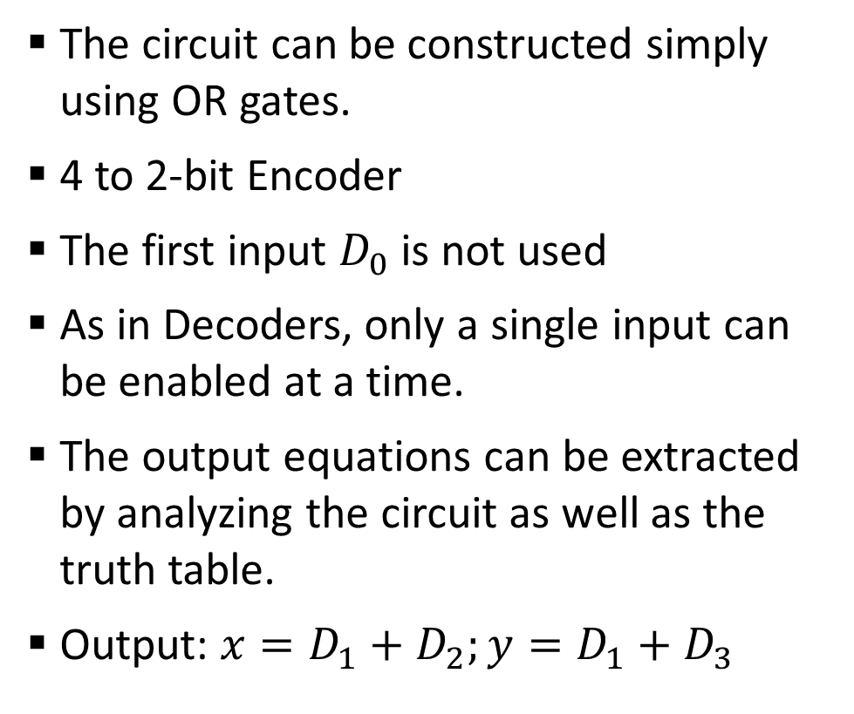
Sample 2
Encoders
The circuit can be constructed simply using OR gates.
4 to 2-bit Encoder
The first input $D_{0}$ is not used
As in Decoders, only a single input can be enabled at a time.
The output equations can be extracted by analyzing the circuit as well as the truth table.
Output: $x=D_{1}+D_{2};y=D_{1}+D_{3}$

Slide 5
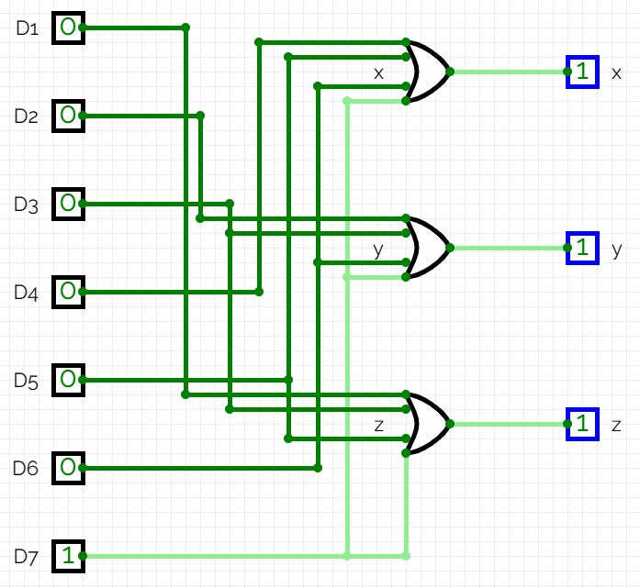
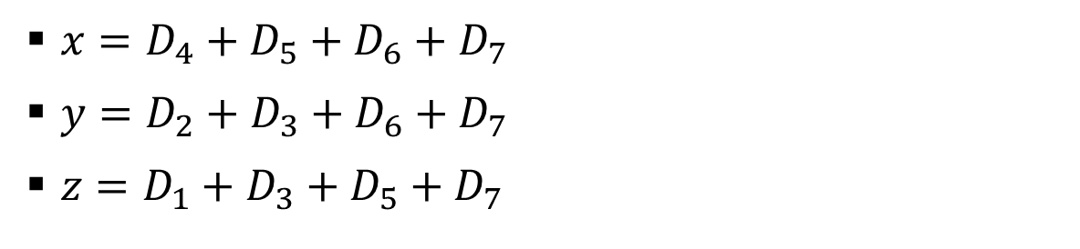
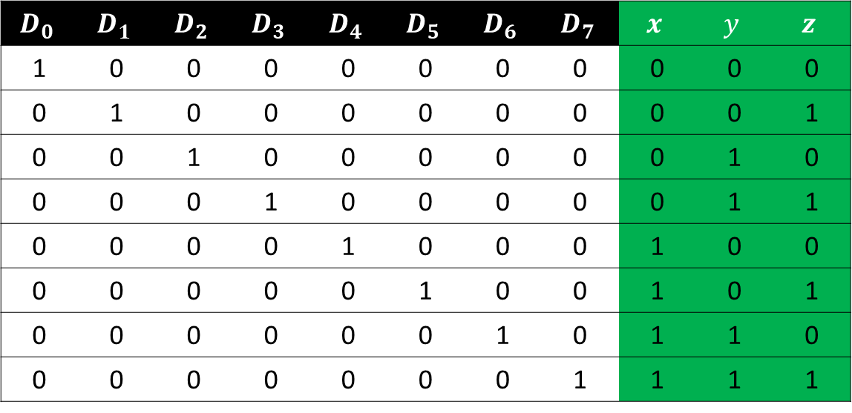
Sample 2
Encoders – Octal Encoders
$x=D_{4}+D_{5}+D_{6}+D_{7}$
$y=D_{2}+D_{3}+D_{6}+D_{7}$
$z=D_{1}+D_{3}+D_{5}+D_{7}$
$$D_{0}$$ | $$D_{1}$$ | $$D_{2}$$ | $$D_{3}$$ | $$D_{4}$$ | $$D_{5}$$ | $$D_{6}$$ | $$D_{7}$$ | $$x$$ | $$y$$ | $$z$$
1 | 0 | 0 | 0 | 0 | 0 | 0 | 0 | 0 | 0 | 0
0 | 1 | 0 | 0 | 0 | 0 | 0 | 0 | 0 | 0 | 1
0 | 0 | 1 | 0 | 0 | 0 | 0 | 0 | 0 | 1 | 0
0 | 0 | 0 | 1 | 0 | 0 | 0 | 0 | 0 | 1 | 1
0 | 0 | 0 | 0 | 1 | 0 | 0 | 0 | 1 | 0 | 0
0 | 0 | 0 | 0 | 0 | 1 | 0 | 0 | 1 | 0 | 1
0 | 0 | 0 | 0 | 0 | 0 | 1 | 0 | 1 | 1 | 0
0 | 0 | 0 | 0 | 0 | 0 | 0 | 1 | 1 | 1 | 1
Notes:
Note that we do not need $D_{0}$

Slide 6
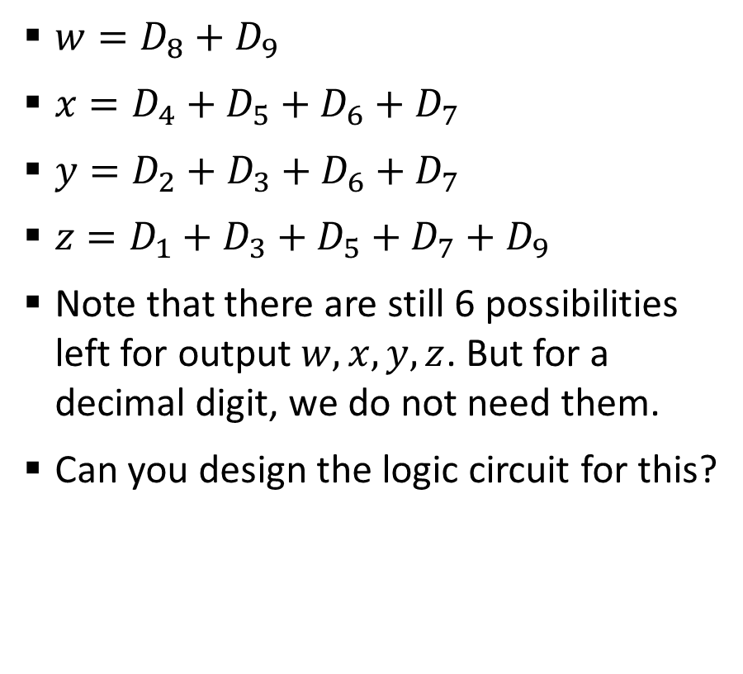
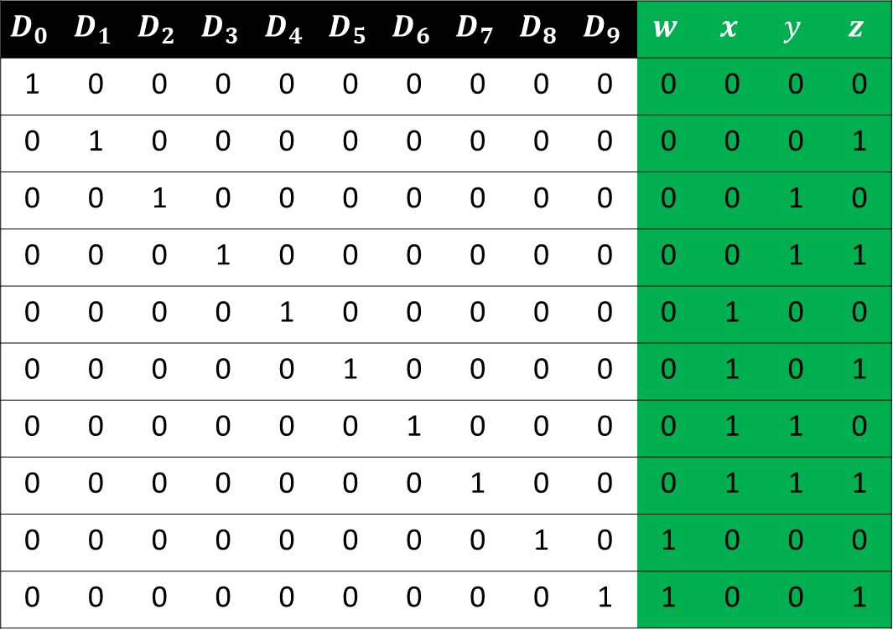
Sample 2
Encoders – Decimal Encoders
$w=D_{8}+$ $D_{9}$
$x=D_{4}+D_{5}+D_{6}+D_{7}$
$y=D_{2}+D_{3}+D_{6}+D_{7}$
$z=D_{1}+D_{3}+D_{5}+D_{7}+D_{9}$
Note that there are still 6 possibilities left for output $w,x,y,z$. But for a decimal digit, we do not need them.
Can you design the logic circuit for this?
$$D_{0}$$ | $$D_{1}$$ | $$D_{2}$$ | $$D_{3}$$ | $$D_{4}$$ | $$D_{5}$$ | $$D_{6}$$ | $$D_{7}$$ | $$D_{8}$$ | $$D_{9}$$ | $$w$$ | $$x$$ | $$y$$ | $$z$$
1 | 0 | 0 | 0 | 0 | 0 | 0 | 0 | 0 | 0 | 0 | 0 | 0 | 0
0 | 1 | 0 | 0 | 0 | 0 | 0 | 0 | 0 | 0 | 0 | 0 | 0 | 1
0 | 0 | 1 | 0 | 0 | 0 | 0 | 0 | 0 | 0 | 0 | 0 | 1 | 0
0 | 0 | 0 | 1 | 0 | 0 | 0 | 0 | 0 | 0 | 0 | 0 | 1 | 1
0 | 0 | 0 | 0 | 1 | 0 | 0 | 0 | 0 | 0 | 0 | 1 | 0 | 0
0 | 0 | 0 | 0 | 0 | 1 | 0 | 0 | 0 | 0 | 0 | 1 | 0 | 1
0 | 0 | 0 | 0 | 0 | 0 | 1 | 0 | 0 | 0 | 0 | 1 | 1 | 0
0 | 0 | 0 | 0 | 0 | 0 | 0 | 1 | 0 | 0 | 0 | 1 | 1 | 1
0 | 0 | 0 | 0 | 0 | 0 | 0 | 0 | 1 | 0 | 1 | 0 | 0 | 0
0 | 0 | 0 | 0 | 0 | 0 | 0 | 0 | 0 | 1 | 1 | 0 | 0 | 1
Notes:
Note that we do not need $D_{0}$

Slide 7
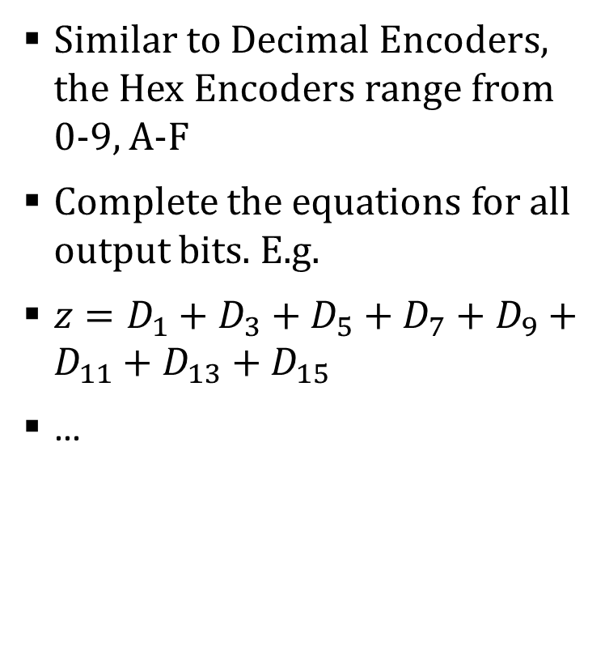
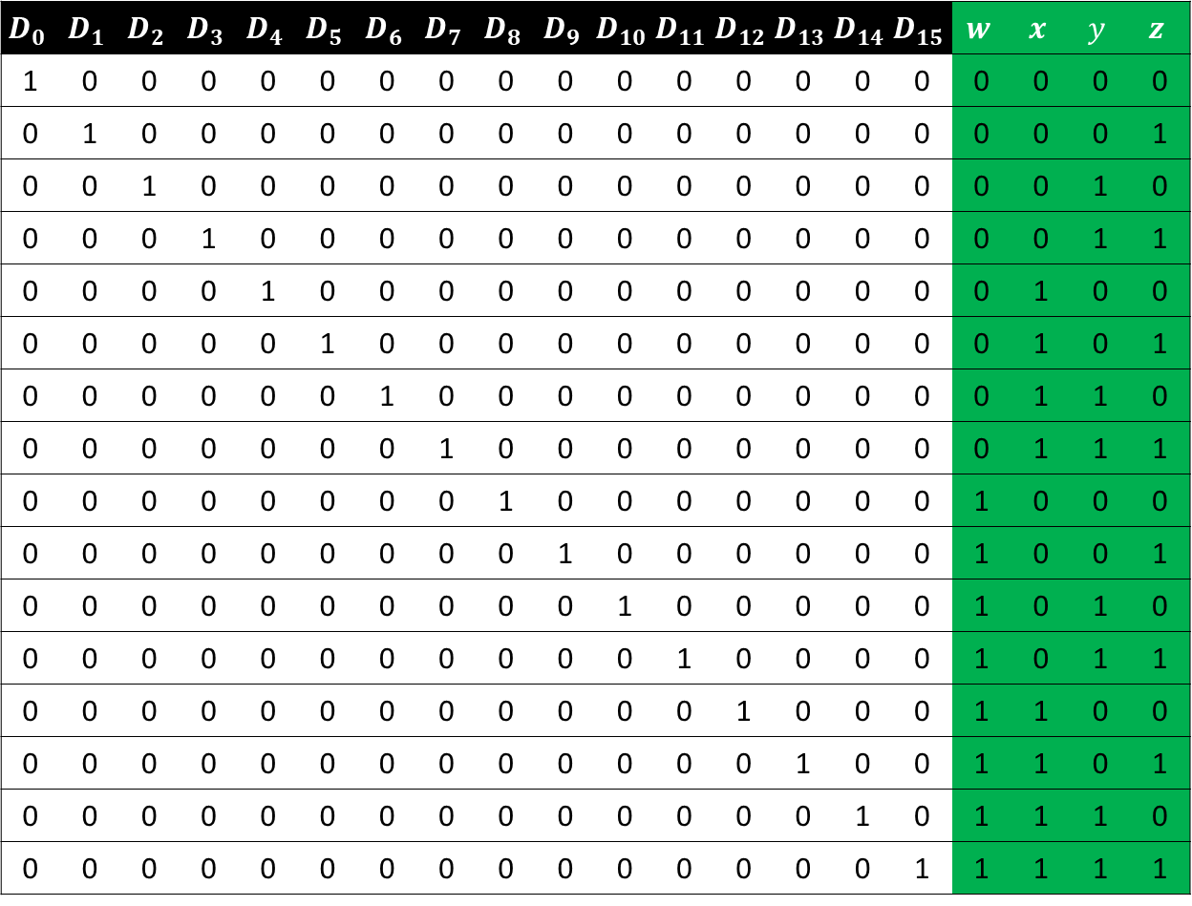
Sample 2
Encoders – Hex Encoders
$$D_{0}$$ | $$D_{1}$$ | $$D_{2}$$ | $$D_{3}$$ | $$D_{4}$$ | $$D_{5}$$ | $$D_{6}$$ | $$D_{7}$$ | $$D_{8}$$ | $$D_{9}$$ | $$D_{10}$$ | $$D_{11}$$ | $$D_{12}$$ | $$D_{13}$$ | $$D_{14}$$ | $$D_{15}$$ | $$w$$ | $$x$$ | $$y$$ | $$z$$
1 | 0 | 0 | 0 | 0 | 0 | 0 | 0 | 0 | 0 | 0 | 0 | 0 | 0 | 0 | 0 | 0 | 0 | 0 | 0
0 | 1 | 0 | 0 | 0 | 0 | 0 | 0 | 0 | 0 | 0 | 0 | 0 | 0 | 0 | 0 | 0 | 0 | 0 | 1
0 | 0 | 1 | 0 | 0 | 0 | 0 | 0 | 0 | 0 | 0 | 0 | 0 | 0 | 0 | 0 | 0 | 0 | 1 | 0
0 | 0 | 0 | 1 | 0 | 0 | 0 | 0 | 0 | 0 | 0 | 0 | 0 | 0 | 0 | 0 | 0 | 0 | 1 | 1
0 | 0 | 0 | 0 | 1 | 0 | 0 | 0 | 0 | 0 | 0 | 0 | 0 | 0 | 0 | 0 | 0 | 1 | 0 | 0
0 | 0 | 0 | 0 | 0 | 1 | 0 | 0 | 0 | 0 | 0 | 0 | 0 | 0 | 0 | 0 | 0 | 1 | 0 | 1
0 | 0 | 0 | 0 | 0 | 0 | 1 | 0 | 0 | 0 | 0 | 0 | 0 | 0 | 0 | 0 | 0 | 1 | 1 | 0
0 | 0 | 0 | 0 | 0 | 0 | 0 | 1 | 0 | 0 | 0 | 0 | 0 | 0 | 0 | 0 | 0 | 1 | 1 | 1
0 | 0 | 0 | 0 | 0 | 0 | 0 | 0 | 1 | 0 | 0 | 0 | 0 | 0 | 0 | 0 | 1 | 0 | 0 | 0
0 | 0 | 0 | 0 | 0 | 0 | 0 | 0 | 0 | 1 | 0 | 0 | 0 | 0 | 0 | 0 | 1 | 0 | 0 | 1
0 | 0 | 0 | 0 | 0 | 0 | 0 | 0 | 0 | 0 | 1 | 0 | 0 | 0 | 0 | 0 | 1 | 0 | 1 | 0
0 | 0 | 0 | 0 | 0 | 0 | 0 | 0 | 0 | 0 | 0 | 1 | 0 | 0 | 0 | 0 | 1 | 0 | 1 | 1
0 | 0 | 0 | 0 | 0 | 0 | 0 | 0 | 0 | 0 | 0 | 0 | 1 | 0 | 0 | 0 | 1 | 1 | 0 | 0
0 | 0 | 0 | 0 | 0 | 0 | 0 | 0 | 0 | 0 | 0 | 0 | 0 | 1 | 0 | 0 | 1 | 1 | 0 | 1
0 | 0 | 0 | 0 | 0 | 0 | 0 | 0 | 0 | 0 | 0 | 0 | 0 | 0 | 1 | 0 | 1 | 1 | 1 | 0
0 | 0 | 0 | 0 | 0 | 0 | 0 | 0 | 0 | 0 | 0 | 0 | 0 | 0 | 0 | 1 | 1 | 1 | 1 | 1
Similar to Decimal Encoders, the Hex Encoders range from 0-9, A-F
Complete the equations for all output bits. E.g.
$z=D_{1}+D_{3}+D_{5}+D_{7}+D_{9}+D_{11}+D_{13}+D_{15}$
…
Notes:
Note that we do not need $D_{0}$

Slide 8
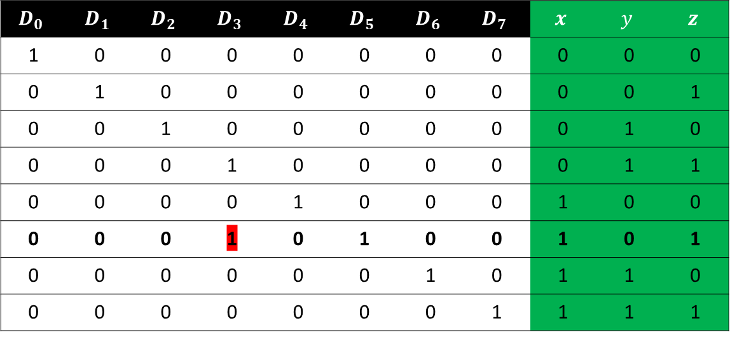
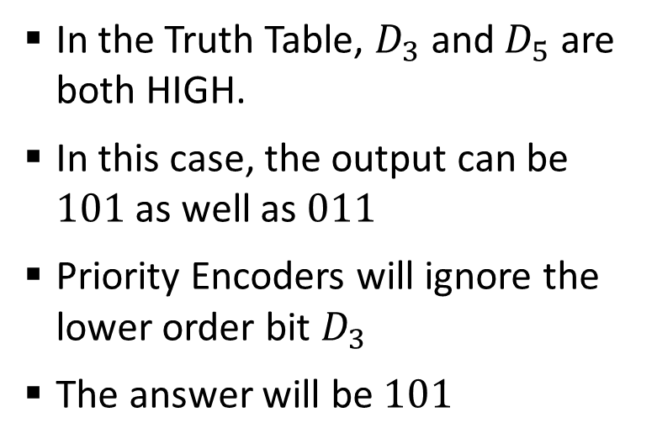
Sample 2
Encoders – Priority Encoders
By design, the Encoders should have only one input signals as HIGH. If more than 1 inputs are high, then there will be multiple outputs with same bits.
The priority function allows the Encoder to produce a BCD output corresponding to the highest-order input. If more than 1 bits are HIGH, then the lower order bits will follow “Don’t care” rule and will be ignored.
$$D_{0}$$ | $$D_{1}$$ | $$D_{2}$$ | $$D_{3}$$ | $$D_{4}$$ | $$D_{5}$$ | $$D_{6}$$ | $$D_{7}$$ | $$x$$ | $$y$$ | $$z$$
1 | 0 | 0 | 0 | 0 | 0 | 0 | 0 | 0 | 0 | 0
0 | 1 | 0 | 0 | 0 | 0 | 0 | 0 | 0 | 0 | 1
0 | 0 | 1 | 0 | 0 | 0 | 0 | 0 | 0 | 1 | 0
0 | 0 | 0 | 1 | 0 | 0 | 0 | 0 | 0 | 1 | 1
0 | 0 | 0 | 0 | 1 | 0 | 0 | 0 | 1 | 0 | 0
0 | 0 | 0 | 1 | 0 | 1 | 0 | 0 | 1 | 0 | 1
0 | 0 | 0 | 0 | 0 | 0 | 1 | 0 | 1 | 1 | 0
0 | 0 | 0 | 0 | 0 | 0 | 0 | 1 | 1 | 1 | 1
In the Truth Table, $D_{3}$ and $D_{5}$ are both HIGH.
In this case, the output can be $101$ as well as $011$
Priority Encoders will ignore the lower order bit $D_{3}$
The answer will be $101$

Slide 9



THANK YOU
Owais Hussain
+92 345-3174270
owais.hussain@kiet.edu.pk
https://www.researchgate.net/profile/Owais-Hussain-3

